Slide 1


AWS Lambda
Serverless
Day 1

Slide 2




Logistics
Class Hours
Start time is 9:00am.
End time is 4:30pm.
Class times may vary slightly for specific classes.
Break every 60 minutes.
Lunch
Lunch is 12:00pm to 1:15pm.
Yes, that’s 1 hour and 15 minutes.
Use time for replying to email, phone calls, or simply taking a walk.
Devices
Turn off or set electronic devices to vibrate.
Attending to devices is distracting to others.
Try to delay until breaks or after class.
Miscellaneous
Courseware
Bathroom
Fire drills

Slide 3

Course Objectives
What is AWS Lambda?
Create an API using AWS Lambda
Use AWS Lambda to automated Ops functions
Design applications to maximize Lambda benefits
Automatically deploy and rollback Lambda functions
Understand critical architectural limitations of Lambda
Build a Lambda based flow that publishes static/JS app

Slide 4




Meet Your Instructor
Jordan Rinke
Principal Engineer focused on cloud native/hybrid technologies with 20 years of experience.
Twitter:
E-Mail:
LinkedIn:
Expertise in:
Cloud
Automation
Kubernetes
Hyperscale
Hyperedge
@jordanrinke
jordan@rin.ke
https://www.linkedin.com/in/jordanrinke/

Slide 5

Introductions
Please tell us your:
Name
Job Role
Lambda/FaaS experience
Expectations for course

Slide 6
Day 1: Objectives
Today, we will talk about what “functions” are, what the current offerings out there are, and get introduced to several AWS products.
We will go through 6 Labs where you will build your first Lambda function and deploy it to production. Over the course of the Labs, we’ll be building a static website in Hugo that is fully serverless and re-deploys on every commit.
Finally we’ll review some of Lambda’s design limitations and special considerations.

Slide 7
Fundamentals

Slide 8

Lab-focused Course
This is a hands-on, functional course.
We will focus on doing labs and learning through interaction with Lambda, and not just looking at slides.
Notes:
We will go into more detail as to what FaaS is specifically but generally speaking it is worth knowing that FaaS is on demand functions, ran as containers, that execute a single command and then potentially terminate. They are guaranteed to eventually be destroyed and recycled. The user or developer does not manage them in any way other than the code that runs for the function and the logical mapping.

Slide 9

FaaS – Functions as a Service
What is FaaS/Serverless?
A FaaS is service built on containers that are executed on demand and are short lived.
You can build an entire application on a FaaS platform and not maintain any infrastructure.
Notes:
We will go into more detail as to what FaaS is specifically but generally speaking it is worth knowing that FaaS is on demand functions, ran as containers, that execute a single command and then potentially terminate. They are guaranteed to eventually be destroyed and recycled. The user or developer does not manage them in any way other than the code that runs for the function and the logical mapping.

Slide 10

AWS Lambda
What is AWS Lambda?
Lambda is the product name of the FaaS offering from AWS.
As the pioneer of FaaS, AWS coined the term “Serverless” and Lambda is the de-facto industry standard today.
It was announced as a technical preview in November of 2014.
https://aws.amazon.com/lambda/

Slide 11

Azure Functions
What are Azure Functions?
Azure announced a Lambda competitor named “Functions” in November of 2016.
Functions currently supports C#, JavaScript, F#, Python, PowerShell, and TypeScript.
It allows you to provide your own completely custom container for unsupported languages.
https://azure.microsoft.com/en-us/services/functions/

Slide 12

Google Cloud Functions
What is Google Cloud Functions?
Google Cloud announced a Lambda competitor named “Cloud Functions” in April of 2016.
Cloud Functions currently supports Python, Node.js, and Go.
It is the least feature rich product among the large FaaS providers.
https://cloud.google.com/functions/

Slide 13

OpenFaaS
What is OpenFaaS?
The initial OpenFaaS commits were in December of 2016.
It is an open-source FaaS framework built to run on Kubernetes.
It has a large ecosystem of prebuilt containers.
It can be self hosted.
https://www.openfaas.com/

Slide 14

Knative
What is Knative?
Knative’s first release was published on Github in July of 2018.
It is the most recent entry into the FaaS space, but officially supported by the CNCF and Kubernetes.
It’s rapidly replacing OpenFaaS as the go-to FaaS platform for Kubernetes, even though it hasn’t hit v1.0/production yet.
https://knative.dev/

Slide 15
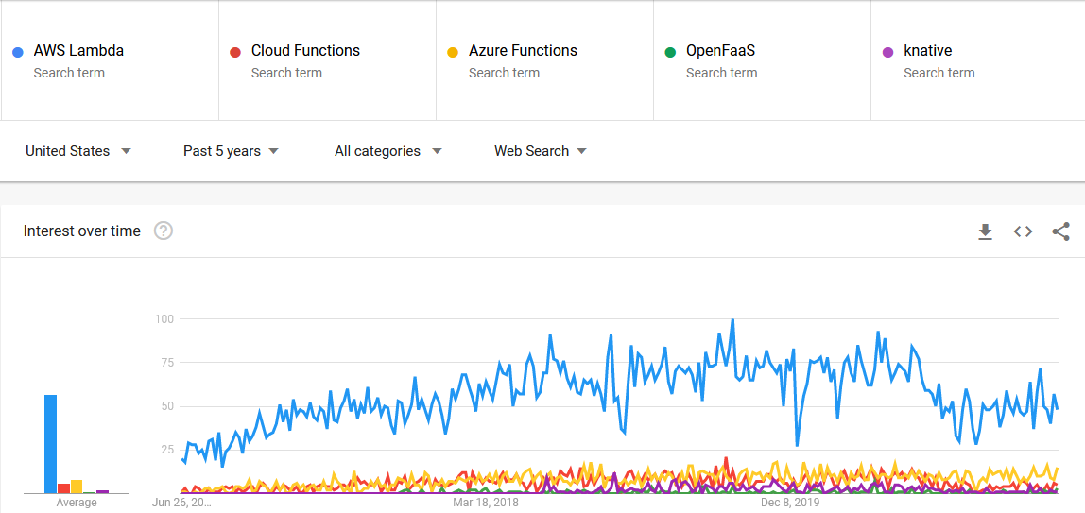
Adoption/Interest Over Time
Notes:
Lambda is by far the market leader. Azure functions comes in second and is growing, Google cloud functions is a third but the release of knative for Kubernetes and GKE has cannibalized it a bit.

Slide 16
Lambda Tradeoffs
Provider Responsibility
Flexibility
With Lambda, you trade a certain amount of flexibility for reduced responsibility, as the responsibility is shifted to the provider running the platform.

Slide 17
Lambda Tradeoffs
Cost per execution
Potential wasted budget
But, Lambda will cost you more per execution at massive scale.
However, you will never waste any resources and you don’t need a team to run it, which can make Lambda much cheaper in many cases.
Notes:
It is easy to get stuck with sticker shock for large scale Lambda projects but that cost is often overall lower than everything requires to run that stack in the same flexible and extensive manner that Lambda is. Everything is based on individual use cases though, cloud repatriation makes sense for certain workloads.

Slide 18
Lambda responsibilities
Traditional VM | Containers | Serverless
Function | Function | Function
Application | Application | Application
Container | Container | Container
Operating System | Operating System | Operating System
Virtual Hardware | Virtual Hardware | Virtual Hardware
Notes:
The further you move to the right the less you control but the less you are responsible for, the more you tap into systems that are maintained for you and meant to scale quickly and very large.

Slide 19
Lab Setup

Slide 20
Lab 1.1 - Create our first Lambda function
Log into the AWS Management Console
Find the Lambda managed console
Create a function using a blueprint
Test your function

Slide 21
Lab 1.1 - Review
Simple functions are very easy to create with the UI/Console.
It is possible to create complex applications using purely the UI, although it is not the most effective way to do it, or the most maintainable.

Slide 22
Development Velocity
How would the ability to rapidly deploy Lambda functions on-demand without any other team interaction change your team's development velocity?

Slide 23
Development Velocity
1. Fast testing with no need to spin up any infrastructure
2. Purely event driven systems with a couple of clicks
3. Scale function sizes on demand without any downtime
4. No traditional infrastructure management/planning

Slide 24

Lambda is containers, Not magic.
Functions are containers that are built with your code injected into them.
Your code is wrapped with a small HTTP server in the container
Your code entry point is registered with the server and Lambda orchestrates it.

Slide 25
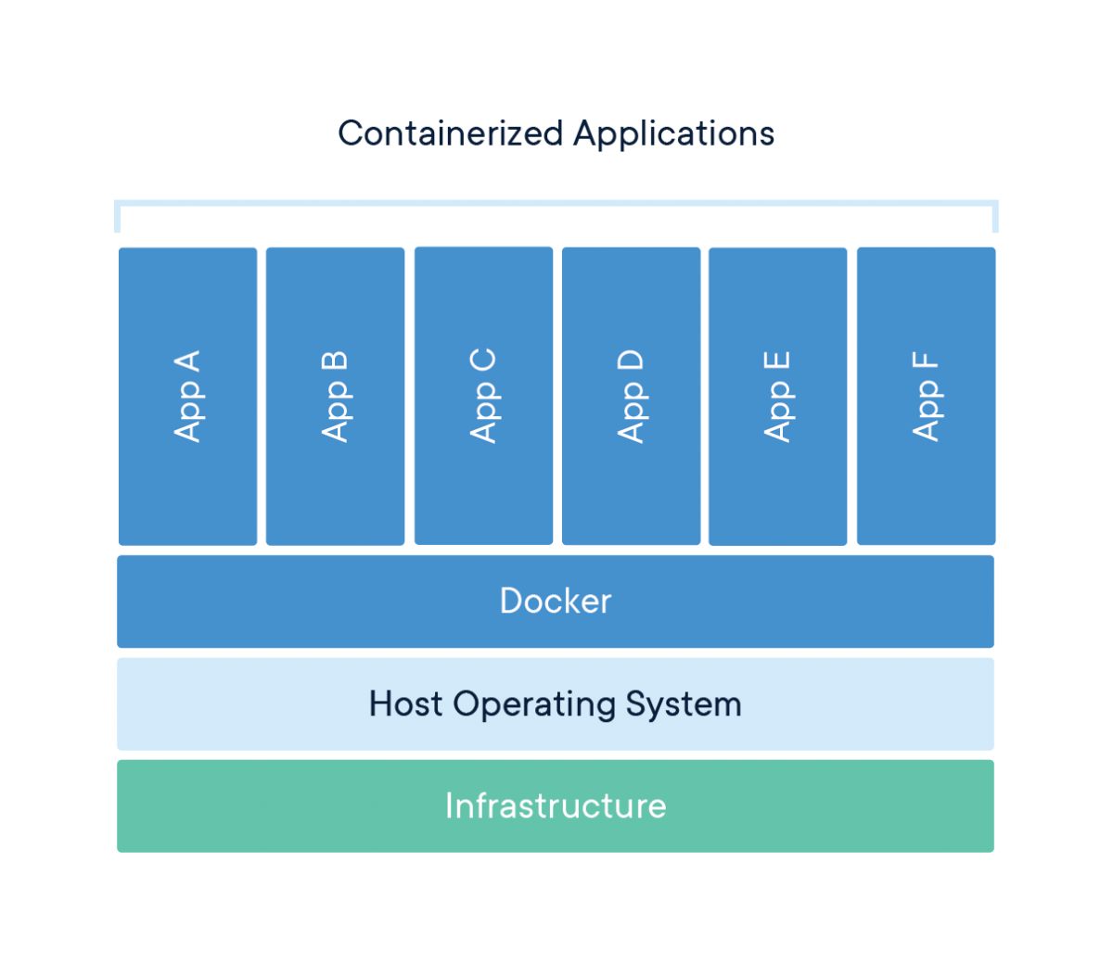
What is a container?
A container is an isolated execution environment for software that guarantees portability between systems.
Containers are a completely reproducable software defined application stack.
Containers offer the lightest weight application isolation possible.
Notes:
Containers (commonly docker but can be others) are an isolated execution environment that is built on a stack of read only layers called images. The last layer is a read/write layer that is the actual running container where the application is capable of interacting/running. They give you a portable way to ship an application in a known working state regardless of the host platform.

Slide 26

Why containers?
Containers are portable between host platforms and providers.
Using techniques we will discuss later, you can move your functions between any provider with little or no modifications.
Notes:
Using docker-lambda you can use your functions in Azure or knative with only small changes (or no changes if you can make changes to the API routing instead)

Slide 27

Why containers?
Containers enable the end-to-end automation of applications and operations.
All container engines are 100% API driven, and even the CLI tools are just calling the APIs.
Notes:
All container orchestration engines are 100% API based enabling software defined automation through the entire stack.

Slide 28
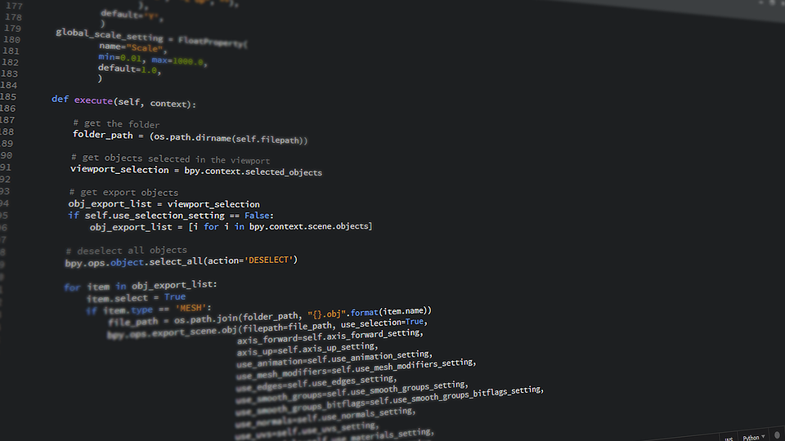
Making a container a function in Lambda
lambda_function.py
Notes:
We write some code

Slide 29
Making a container a function in Lambda
lambda_function.py
ZIP
Notes:
We zip it up.

Slide 30
Making a container a function in Lambda
lambda_function.py
ZIP
Upload to AWS
Notes:
We upload it to AWS. Bam. Done…. Bbuuutt… what really happens?

Slide 31
Making a container a function in Lambda
What really happens?
Notes:
We upload it to AWS. Bam. Done…. Bbuuutt… what really happens?

Slide 32
Making a container a function in Lambda
Python File
Upload to AWS
Container
Notes:
We upload it to AWS. Bam. Done…. Bbuuutt… what really happens?

Slide 33
Making a container a function in Lambda
Upload to AWS
Container
Python File
Notes:
The file is uploaded to Lambda, the zip is then unzipped into a container with the runtime you selected.

Slide 34
Making a container a function in Lambda
Container
HTTP Handler
Python File
Handler Function
Notes:
The function handler inside of that file is registered with the HTTP handler in the container

Slide 35
Making a container a function in Lambda
Function Name
Container
HTTP Handler
Python File
Handler Function
Notes:
That container and handler are then the “function” that you have created. Any requests to it go through the HTTP handler (a proxy basically) and then it calls the file and function you have listed for that particular function.

Slide 36
Lab Setup

Slide 37
Lab 1.2 - Create a function from the CLI
Create the same function from Lab #1 using only the AWS CLI.
Run/Invoke the function from the CLI using a custom payload.

Slide 38
Lab 1.2 - Review
It’s easy to deploy relatively simple functions from the command line just using the CLI and a zip file.
Chaining additional resources together can be complicated with the CLI, which we will address in Day 2’s Labs with frameworks.

Slide 39




Gluing functions together
Lambda’s major advantage is its extensive integration with other AWS services.
Almost every AWS service that emits an event can be used to trigger a Lambda function and can be configured in the UI or via the CLI.

Slide 40

AWS API gateway
Defines HTTP/HTTPS endpoints and routing for Lambda functions.
Configure API versions
Weighted routing
Payload mapping
You can customize how data passed to the API is passed to your functions, to decouple schemas/allow migrations

Slide 41
AWS SQS (Simple queue service)
Hosted message bus.
SQS usually must be polled, but Lambda has integrations that can be triggered when messages are waiting.
Configurable batch size.
Messages are guaranteed to be consumed only once.

Slide 42

AWS SNS (Simple Notification service)
Hosted message bus (Pub/Sub).
SNS differs from SQS in that it can deliver the same message to multiple receivers/services.
SNS can push notifications to mobile platforms in addition to Lambda.

Slide 43
AWS s3 (object storage)
Lambda can receive events from S3 buckets.
S3 can run a Lambda function when objects are created, deleted, updated.
Common examples are processing image files, or application artifacts for deployment.

Slide 44
AWS dynamodb (Key/value store)
Lambda can receive events from DynamoDB directly.
Dynamo can pass Lambda the entire data blob of what was added or changed in a single request.
Use DynamoDB as a trigger to take action on persistent data. e.g. instead of using an API to take action on an e-commerce order, you could process it with a Lambda function based on the order being saved.

Slide 45

AWS cloudwatch (events/logs)
Cloudwatch can Receive logs and events from all monitorable AWS services.
Cloudwatch can call Lambda functions to perform automated remediation and notification processes.
In a later lab, we will use Cloudwatch events to automatically roll back a broken deployment.

Slide 46

AWS kinesis (data streams)
Massive scale data stream ingestion processing
Large batch sizes
Begin reading from anywhere in the stream, including from the very beginning to re-processes data

Slide 47
What can’t you do with Lambda?
Given all the possible event types and AWS services integrations from Lambda, can you think of anything you couldn’t use a Lambda function for?

Slide 48
What can’t you do with Lambda?
Long running functions. Lambda has certain time limits. Other services may be a better choice for that.
Tasks needing massive amounts of memory
Anything that needs persistent data in the container

Slide 49

Building something useful
Over the next few labs, we will build a blog.
We will use Lambda functions to generate a static site using Hugo.
We will use Lambda functions to store comments in DynamoDB.
Our site will be statically hosted on s3.
The entire blog will be run “serverless,” but have a fully automated deployment process.

Slide 50
Architecture: Our Blog
Commit
Notes:
Everything starts with a commit.

Slide 51
Architecture: Our Blog
Commit
Github
Notes:
That commit is pushed to Github

Slide 52
Architecture: Our Blog
Commit
Github
Webhook
Notes:
Github fires off a webhook with the commit/push event

Slide 53
Architecture: Our Blog
Commit
Github
Webhook
API Gateway
Notes:
That webhook goes through the API Gateway

Slide 54
Architecture: Our Blog
Commit
Github
Webhook
API Gateway
Lambda Function
git
Hugo
AWS CLI
Notes:
To our Lambda function via a Lambda Proxy

Slide 55
Architecture: Our Blog
Commit
Github
Webhook
API Gateway
Lambda Function
git
Hugo
AWS CLI
Notes:
Our Function processes the webhook and begins a git clone of the repository locally

Slide 56
Architecture: Our Blog
Commit
Github
Webhook
API Gateway
Lambda Function
git
Hugo
AWS CLI
Notes:
One the clone is complete, hugo is called to compile the site

Slide 57
Architecture: Our Blog
Commit
Github
Webhook
API Gateway
Lambda Function
git
Hugo
AWS CLI
Notes:
After hugo compiles the site the AWS CLI is used to sync the content with S3

Slide 58
Architecture: Our Blog
Commit
Github
Webhook
API Gateway
Lambda Function
git
Hugo
AWS CLI
S3/HTML
Notes:
After hugo compiles the site the AWS CLI is used to sync the content with S3

Slide 59
Architecture: Our Blog
Commit
Github
Webhook
API Gateway
Lambda Function
git
Hugo
AWS CLI
S3/HTML
User
Notes:
Users are now able to view our static website

Slide 60
How would you build our blog?
With what you know of Lambda and all the AWS services currently, how would you design a completely serverless blog that is generated on a push to a git repo and can store comments?
Notes:
Open ended discussion, this can stretch a while or be really short. If no one has any ideas it is simple to just move on, or spend a while exploring ideas with the class.

Slide 61
Logging
By default, all Lambda functions create a log stream in CloudWatch that log their execution time and billed time.
All built-in logging packages work. Print statements are all that’s needed to output data to CloudWatch.
We will use Print statements for simple debugging initially, and we will cover proper debugging of functions on Day 2.

Slide 62
Lab Setup

Slide 63
Lab 1.3 - Call a Lambda function on commit to master
You will need your own GitHub account. Use an existing one or create a new one.
We will be using a public repo to host our blog content.
The first thing we need to do is get GitHub talking to our Lambda functions, we will use an API gateway for this.
In this Lab, we are only interested in getting the communication working, we won’t be doing anything with the call from the webhook except logging it.
Note: If you get a "Missing Authentication Token“ error, this is not an auth issue. Check the path/url you are calling. This happens if you hit a non-existent API endpoint. The error message is not useful and can waste a lot of time looking at the wrong thing.

Slide 64
Lab 1.3 - Review
The API Gateway requires that all responses are proper HTTP responses including a status code and a body.
If we hit an endpoint that doesn’t exist in the API Gateway, instead of getting a 404 Not Found error, we will get an error related to Authorization. This can be extremely confusing if it is your first time working with the API gateway.
Always validate the URL path you are calling and the method you are calling. If you call a proper path but do not use the correct HTTP verb, you will get the same missing authorization error.

Slide 65

Lambda Layers
Lambda supports using layers to compose a function with additional features
Layers can be published for other people to use them
You can build your own layers and re-use them in multiple functions (for example, a common SDK)
Layers are zip files that are unzipped to a predefined location in the function container, in order.

Slide 66
Lab Setup

Slide 67
Hugo
Hugo is a fast and modern static site generator, written in Go.
There is no API for Hugo. It is a single binary, so we will add it to our Lambda function from Lab 3 as a new layer.
Hugo converts Markdown files into a static HTML site using templates.
Using Hugo, we can maintain our blog in GitHub, and then use Lambda to clone it, convert it, and deploy it to an AWS S3 bucket hosting a public site with nothing to manage other than the content and the code.

Slide 68
Lab 1.4 - Build and deploy a Hugo site on commit
In this lab, we will expand the function from Lab 3 by using a layer for Hugo and a layer for the AWS CLI.
The Hugo layer will compile our site into static HTML.
The AWS CLI layer will be used to sync the content we generate with the s3 bucket hosting our public site.

Slide 69

Design limitations
So far, everything has been relatively easy to glue together. This is the primary draw of using Lambda.
All the complexity lurks in the finer details of less common use cases and larger system designs.

Slide 70
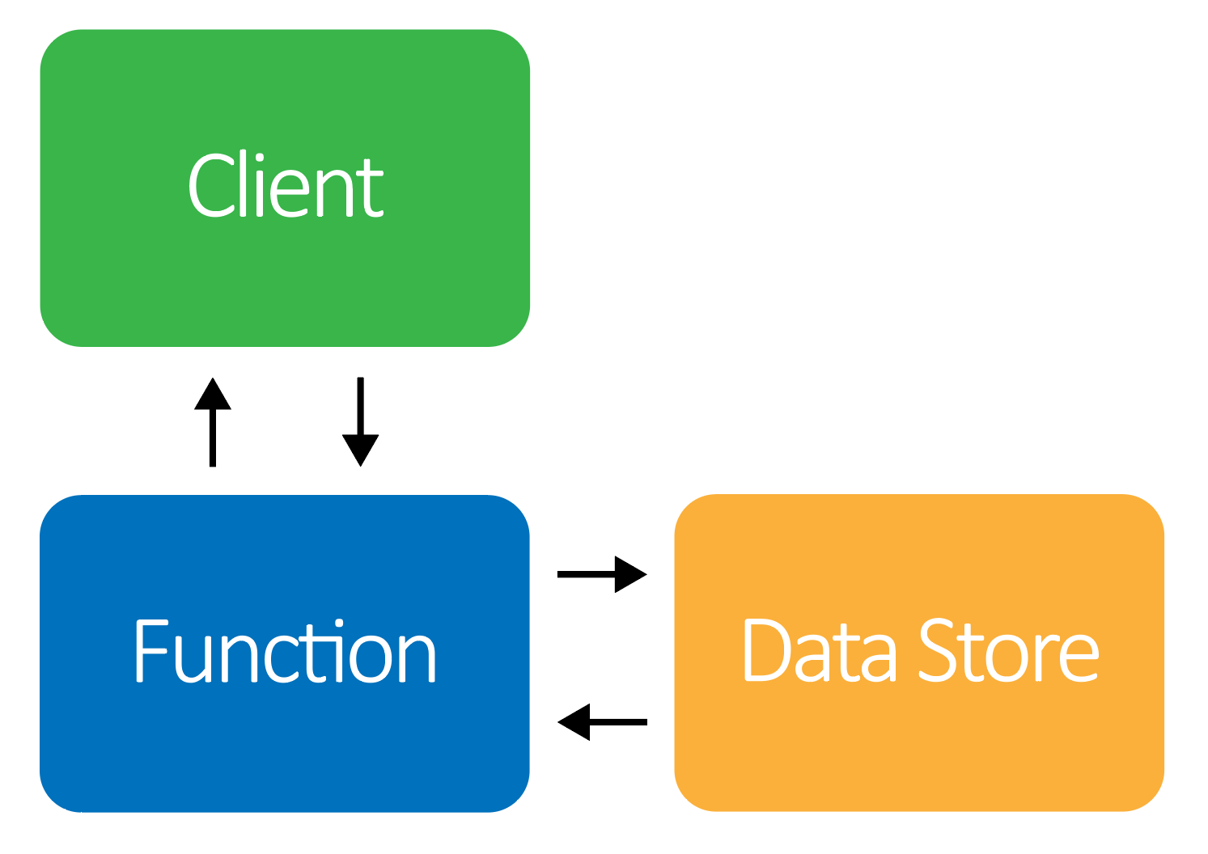
Design limitations: Stateless
Data does not persist between function calls.
Notes:
We used the environment variables to configure our Github secret, and the bucket we are pushing Hugo to.

Slide 71
Design limitations: Stateless
Data does not persist between function calls.
All data must be passed in to the function or fetched by the function from another source.
Notes:
We used the environment variables to configure our Github secret, and the bucket we are pushing Hugo to.

Slide 72
Design limitations: Stateless
Data does not persist between function calls.
All data must be passed in to the function or fetched by the function from another source.
Some configuration can be passed in at runtime via Context and Environment Variables.
Notes:
We used the environment variables to configure our Github secret, and the bucket we are pushing Hugo to.

Slide 73
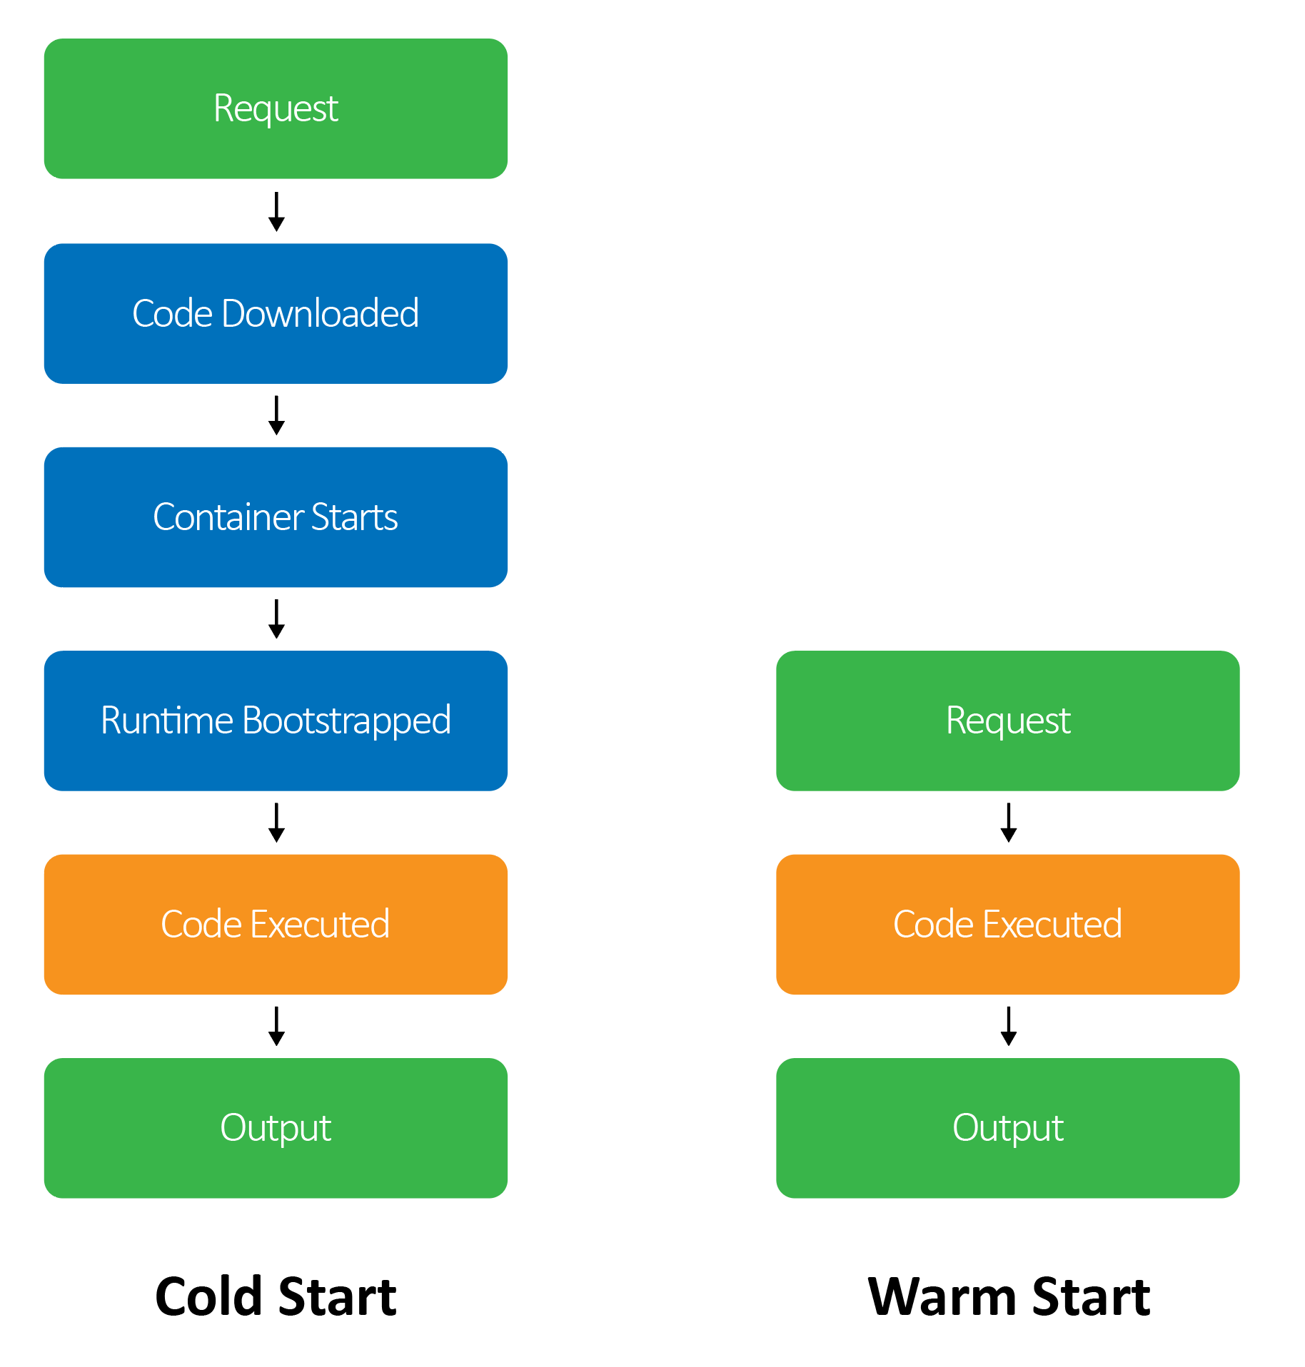
Design limitations: Variable Start Time
Containers can take many seconds to start the first time they run. This is called a “cold” start.

Slide 74
Design limitations: Variable Start Time
Containers can take many seconds to start the first time they run. This is called a “cold” start.
Once a container is running or is “warm”, execution time is generally quick, with very little overhead.

Slide 75
Design limitations: Variable Start Time
Containers can take many seconds to start the first time they run. This is called a “cold” start.
Once a container is running or is “warm”, execution time is generally quick, with very little overhead.
The VMs that AWS uses to run Lambda functions are recycled every 4 hours. You will experience a cold start at least once every 4 hours.

Slide 76
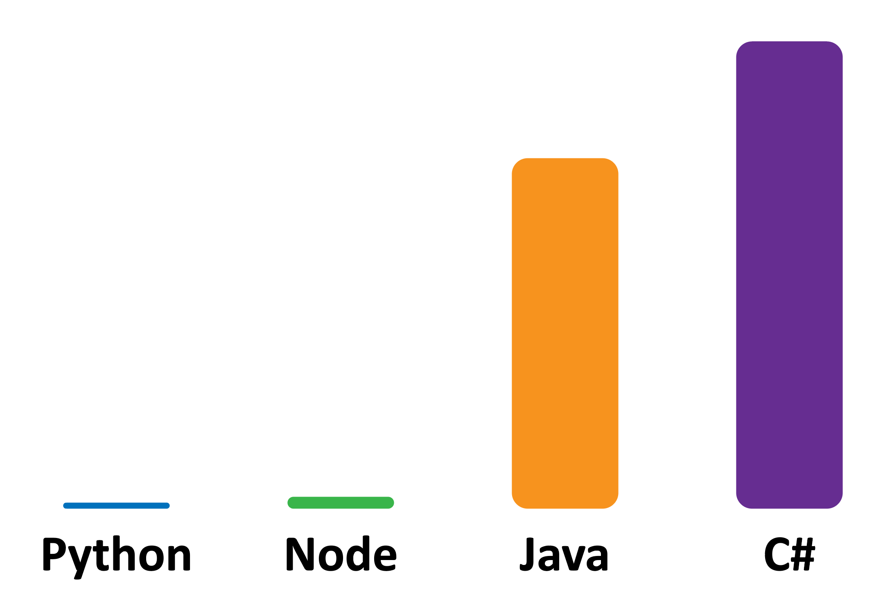
Variable Start Time: Optimizations
The language you use impacts your cold start time.

Slide 77
Variable Start Time: Optimizations
The language you use impacts your cold start time.
Configuration impacts start time. Using a Lambda function in a VPC can add 10 seconds of start time if the cold start is on a new host.

Slide 78
Variable Start Time: Optimizations
The language you use impacts your cold start time.
Configuration impacts start time. Using a Lambda function in a VPC can add 10 seconds of start time if the cold start is on a new host.
The more memory your function is configured for, the faster it starts.
Notes:
We change the size of our function in the lab 4 so hugo could run quickly. We increased the size from the 128mb default to 512mb

Slide 79
Variable start time: Average cold start time
Language | 128MB Mean Time | 256MB Mean Time | 512MB Mean Time | 1024MB Mean Time | 1536MB Mean Time
C# | 4387ms | 2234ms | 1223ms | 524ms | 407ms
Java | 3562ms | 1979ms | 999ms | 539ms | 339ms
Node | 12ms | 8ms | 3ms | 2ms | 2ms
Python | 1ms | 0.8ms | 0.4ms | 0.4ms | 0.4ms

Slide 80
How can we prevent cold starts?
What strategies can we use to limit or even fully prevent them?
Notes:
Answers in the next few slides

Slide 81

Variable Start Time: Prevention
Use a Lambda Step function with a Task Timer to call itself every 5 minutes to “warm” your function.

Slide 82
Variable Start Time: Prevention
Use a Lambda Step function with a Task Timer to call itself every 5 minutes to “warm” your function.
Set a CloudWatch event timer to call a function like a CRON job.

Slide 83
Variable Start Time: Prevention
Use a Lambda Step function with a Task Timer to call itself every 5 minutes to “warm” your function.
Set a CloudWatch event timer to call a function like a CRON job.
Build in short-circuit paths to prevent wasting money processing a “warming” call.

Slide 84

Variable Start Time: Prevention – At scale
Pre-warm your functions at the a slightly higher scale than your expected user load

Slide 85
Variable Start Time: Prevention – At scale
Pre-warm your functions at the a slightly higher scale than your expected user load
Increasing concurrency with load without pre-warming means users above your average load will experience cold starts
Notes:
As you need to run more horizontally scaled functions, those new functions need to spin up. They will also fairly likely be on new hosts, increasing the cold start time to it’s maximum value, especially if using a VPC that has to be setup on the new host the first time.

Slide 86

Design limitations: Limited run time
The default run time for a Lambda function is 3 seconds.

Slide 87
Design limitations: Limited run time
The default run time for a Lambda function is 3 seconds.
The maximum run time for a Lambda function is 300 seconds.
Notes:
We increased the runtime to 30 seconds in Lab 4

Slide 88
Design limitations: Limited run time
The default run time for a Lambda function is 3 seconds.
The maximum run time for a Lambda function is 300 seconds.
AWS API Gateway has an unconfigurable timeout of 30 seconds.
Notes:
We increased the runtime to 30 seconds in Lab 4. Be very aware of the API Gateway timeout, it can cause some headache for long running functions if you are getting timeouts from the REST API but your function still shows that it is completing successfully.

Slide 89
Design limitations: Limited run time
The default run time for a Lambda function is 3 seconds.
The maximum run time for a Lambda function is 300 seconds.
AWS API Gateway has an unconfigurable timeout of 30 seconds.
Be very aware of the API Gateway timeout, as it can cause some headache for long-running functions. If your function takes too long to complete, it can timeout from the REST API, even though your function still shows it completed successfully.

Slide 90
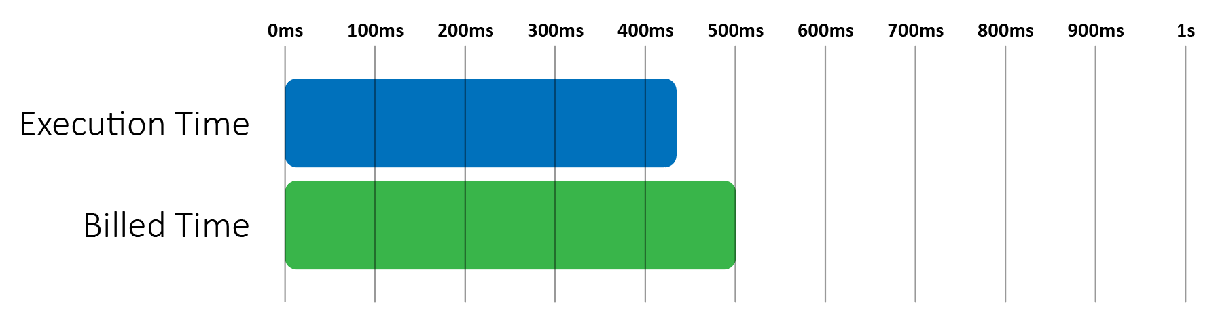
Design limitations: Cost
Functions are billed in 100ms increments and are always rounded up.

Slide 91
Design limitations: Cost
Functions are billed in 100ms increments and are always rounded up.
You are still billed if your function crashes or is terminated.

Slide 92
Design limitations: Cost
Functions are billed in 100ms increments and are always rounded up.
You are still billed if your function crashes or is terminated.
If you exceed your memory, your function will be terminated but you will still be billed.

Slide 93
Design limitations: Cost
Functions are billed in 100ms increments and are always rounded up
You are still billed if your function crashes or is terminated
If you exceed your memory, your function will be terminated but you will still be billed.
A crashing function being called by an application with fast retries can burn through a lot of budget very quickly at scale.

Slide 94
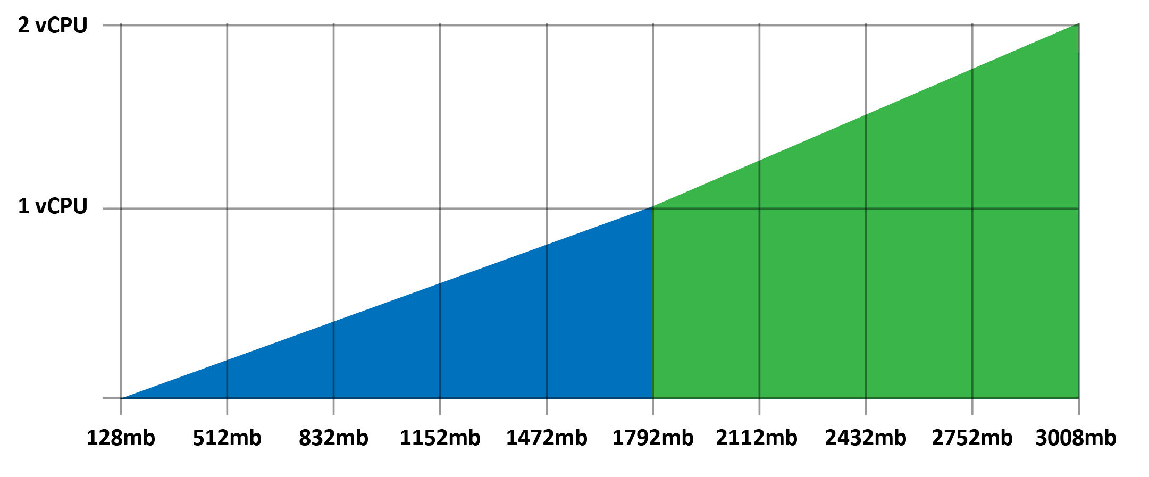
Cost: Optimization – Time is money
Functions receive proportional vCPU time, so the more memory you allocate to a function the more vCPU time it receives.

Slide 95
Cost: Optimization – Time is money
Functions receive proportional vCPU time, so the more memory you allocate to a function the more vCPU time it receives.
After 1792MB your function has access to an additional vCPU.

Slide 96
Cost: Optimization – Time is money
Functions receive proportional vCPU time, so the more memory you allocate to a function the more vCPU time it receives.
After 1792MB your function has access to an additional vCPU.
If your application is not multi-threaded, this CPU is wasted.

Slide 97
Cost: Optimization – Time is money
Functions receive proportional vCPU time, so the more memory you allocate to a function the more vCPU time it receives.
After 1792MB your function has access to an additional vCPU.
If your application is not multi-threaded, this CPU is wasted.
Test and benchmark your functions. It may be cheaper to run more instances with less memory or refactor into smaller pieces.

Slide 98
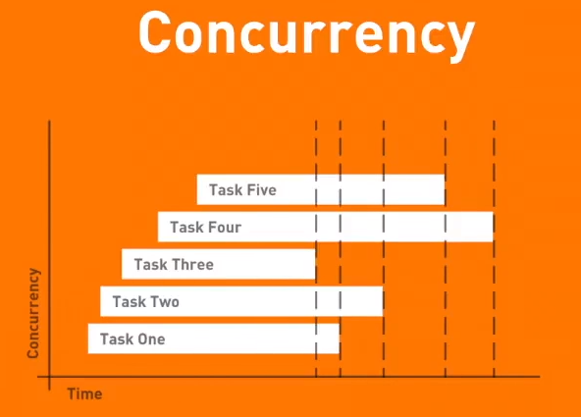
Design limitations: Concurrency
By default, your account has a limit of 1000 concurrent functions.
This can be increased by request through a support ticket.
You can configure reserved concurrency, dedicating a portion of your overall account concurrency for a specific function.

Slide 99
Why reserve concurrency?
Why would we want to reserve concurrency for specific functions?

Slide 100
Why reserve concurrency?
If you have a front and back end process, your front end process can consume all of your concurrency on a spike and the back end will be unable to process functions. Your application will be permanently hard locked, unless you throttle it.

Slide 101
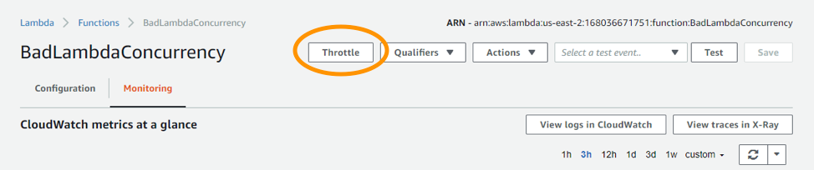
Concurrency: Throttling
If you exhaust your concurrency and your application hangs, there is a throttle button in the UI that will immediately turn concurrency to 0 for the function, allowing you to recover.

Slide 102
Concurrency: Throttling
If you exhaust your concurrency and your application hangs, there is a throttle button in the UI that will immediately turn concurrency to 0 for the function, allowing you to recover.
If you hit your account concurrency limit, throttling events will be recorded in CloudWatch.

Slide 103
Architecture: Our Blog – with comments
Git-webhook
Commit
Github
Webhook
API Gateway
git
Comment
User
S3/HTML
Hugo
Comment Form
AWS CLI
Notes:
We add a comment function to the git-webhook for rendering the comments. We add a comment form to that static HTML that a user can interact with

Slide 104
Architecture: Our Blog – with comments
Git-webhook
Commit
Github
Webhook
API Gateway
git
Comment
User
S3/HTML
Hugo
Comment Form
API Gateway
AWS CLI
Notes:
Comment form submits to the API gateway via JS so it is Restful

Slide 105
Architecture: Our Blog – with comments
Git-webhook
Commit
Github
Webhook
API Gateway
git
Comment
User
S3/HTML
Hugo
Comment Form
API Gateway
AWS CLI
Comment-post
Notes:
API Gateway calls our comment-post function using the Lambda proxy

Slide 106
Architecture: Our Blog – with comments
Git-webhook
Commit
Github
Webhook
API Gateway
git
Comment
User
S3/HTML
Hugo
Comment Form
API Gateway
AWS CLI
Comment-post
DynamoDB
Notes:
Comment-post saves the comment into our DynamoDB table

Slide 107
Architecture: Our Blog – with comments
Git-webhook
Commit
Github
Webhook
API Gateway
git
Comment
User
S3/HTML
Hugo
Comment Form
API Gateway
AWS CLI
Dynamo-stream
Comment-post
DynamoDB
Notes:
The DynamoDB table itself triggers an event, that event is mapped to call the Dynamo-stream lambda function

Slide 108
Architecture: Our Blog – with comments
Git-webhook
Commit
Github
Webhook
API Gateway
git
Comment
User
S3/HTML
Hugo
Comment Form
API Gateway
AWS CLI
Dynamo-stream
Comment-post
DynamoDB
Notes:
Dynamo-stream called our git-webhook function, it passes it a payload similar to what github pushes so we can re-use the same function

Slide 109
Architecture: Our Blog – with comments
Git-webhook
Commit
Github
Webhook
API Gateway
git
Comment
User
S3/HTML
Hugo
Comment Form
API Gateway
Comment-get
AWS CLI
Dynamo-stream
Comment-post
DynamoDB
Notes:
Our new comment method inside of the git-webhook function calls the comment-get function to get a list of comments for each page.

Slide 110
Architecture: Our Blog – with comments
Git-webhook
Commit
Github
Webhook
API Gateway
git
Comment
User
S3/HTML
Hugo
Comment Form
API Gateway
Comment-get
AWS CLI
Dynamo-stream
Comment-post
DynamoDB
Notes:
Comment-get scans the DynamoDB table and returns comments if there are any

Slide 111
Architecture: Our Blog – with comments
Git-webhook
Commit
Github
Webhook
API Gateway
git
Comment
User
S3/HTML
Hugo
Comment Form
API Gateway
Comment-get
AWS CLI
Dynamo-stream
Comment-post
DynamoDB
Notes:
Comments are injected before the site is rendered with hugo, it is rendered and published to S3 same as before

Slide 112
Lab Setup

Slide 113
Lab 1.5 - Adding comments to our static site
In this lab, we are going to start adding additional functionality to our site.
We will use a lambda function to:
Receive form submissions.
Add them to a Dynamo DB table.
Create a static file of comments that will be added to our Hugo template when rendered.
Notes:
If students are having trouble with an error saying they don’t have authentication to invoke lambda functions, they can attach a LambdaFullAccess policy to the role they created for their functions in the IAM management console. The one provided in the class should be enough but I have had random issues with it before.

Slide 114
Lab 1.5 - Review
This time, we used JS code in our HTML site to submit our form as JSON to the API Gateway
We used a DynamoDB event to trigger the recompiling and deployment of our static site. We could have called the function to do that via the Lambda function that saved the comment in DynamoDB but using the event system in AWS is a cleaner and more effective way to build process pipelines.
If we needed to edit a comment in the table or manipulate it in any way, the events would wire and guarantee our site is up-to-date even if they didn’t come in from the form function. We have less places we need to glue things together with code.

Slide 115
How else could we add comments?
Now that we have a working comment system, and given what you know of Lambda, what other ways could we add the same functionality?
What if we wanted to add more functionality?
Notes:
Another open ended conversation, there are a lot of different ways to do this. There are a couple of systems for Hugo, one is a built in discuss module, there is another called staticman that uses a similar serverless setup but instead of using a dynamodb it opens actual github pull requests with the comments straight into the markdown files.

Slide 116
Adding Features - Preventing breaking changes
Every time we upload new code, the function is immediately replaced.
Even with great unit and integration tests this is still a risk in large production systems.
There is a way we can roll out new code in a controlled manner, using function aliases.

Slide 117

Adding Features: Function Aliases
Aliases allow you to point at a named stable version of a function
This can be used to create API versions
Aliases can also be used for Canary deployments with percentage traffic shifting
You can dynamically change the % of traffic going to each version in a named alias

Slide 118
Adding Features: Canary Deployment
Canary deployments allow you to pass a percentage of traffic to a new function version
If there are errors you can reduce the amount of traffic going to the new version to troubleshoot or roll it back completely
If any users are impacted the blast radius is greatly reduced, you can “test” functions in production before doing a full transition
Traffic
API Gateway

Slide 119
Adding Features: Canary Deployment
Canary deployments allow you to pass a percentage of traffic to a new function version
If there are errors you can reduce the amount of traffic going to the new version to troubleshoot or roll it back completely
If any users are impacted the blast radius is greatly reduced, you can “test” functions in production before doing a full transition
Traffic
API Gateway
Alias

Slide 120
Adding Features: Canary Deployment
Canary deployments allow you to pass a percentage of traffic to a new function version
If there are errors you can reduce the amount of traffic going to the new version to troubleshoot or roll it back completely
If any users are impacted the blast radius is greatly reduced, you can “test” functions in production before doing a full transition
v1
v1
v1
Traffic
API Gateway
75%
Alias

Slide 121
Adding Features: Canary Deployment
Canary deployments allow you to pass a percentage of traffic to a new function version
If there are errors you can reduce the amount of traffic going to the new version to troubleshoot or roll it back completely
If any users are impacted the blast radius is greatly reduced, you can “test” functions in production before doing a full transition
v1
v1
v1
Traffic
API Gateway
75%
Alias
25%
v2

Slide 122
Lab 1.6 – Deploy a new comment rendering function with a canary
In this lab, we are going to change the display of our comments and deploy it using a canary system and then test it using the command line.
We will use a function aliases to:
Deploy a new function with a 50% traffic split
Configure the API Gateway to use the new alias
Notes:
If students are having trouble with an error saying they don’t have authentication to invoke lambda functions, they can attach a LambdaFullAccess policy to the role they created for their functions in the IAM management console. The one provided in the class should be enough but I have had random issues with it before.

Slide 123
Lab 1.6 – Review
We created a new “prod” alias for our function and set the traffic weighting to 50%
We changed the API gateway to use the new alias via the UI
Why didn’t we use the CLI? The CLI requires enough steps that the lab gets very complicated. You are free to use some extra time to look at the CLI process, we will do the same thing in a simpler format tomorrow using a framework
We tested our remote function using a curl command through the API gateway
Notes:
If students are having trouble with an error saying they don’t have authentication to invoke lambda functions, they can attach a LambdaFullAccess policy to the role they created for their functions in the IAM management console. The one provided in the class should be enough but I have had random issues with it before.

Slide 124

Day 1: architecture discussion and review
Develop a passion for learning.

Slide 125
Day 1: Architecture – What we built
Our first Lambda function using the UI
A simple hello-world blueprint to demonstrate the Lambda management console.

Slide 126
Day 1: Architecture – What we built
Our first Lambda function using the UI
A Lambda function using the CLI
The same function deployed using the CLI.
This is the most common way that you will interact with Lambda during your development process when not using a fully automated CI/CD pipeline.

Slide 127
Day 1: Architecture – What we built
Our first Lambda function using the UI
A Lambda function using the CLI
An API Gateway connected to a Lambda function to consume GitHub webhook events
The basic building blocks of most serverless architectures.
An API gateway routing all requests that hit a specific endpoint, to a specific Lambda function.
Designed to validate and consume a GitHub webhook, this is also the first building block of a deployment pipeline.

Slide 128
Day 1: Architecture – What we built
Our first Lambda function using the UI
A Lambda function using the CLI
An API Gateway connected to a Lambda function to consume GitHub webhook events
A static site generated from a GitHub webhook
A simple but functional automated deployment pipeline that hosts a publicly accessible website which is built on commit.
Entirely serverless with no infrastructure management required.

Slide 129
Day 1: Architecture – What we built
Our first Lambda function using the UI
A Lambda function using the CLI
An API Gateway connected to a Lambda function to consume GitHub webhook events
A static site generated from a GitHub webhook
A Lambda function to combine dynamic and static content
Combined user interaction, with front and back end systems to integrated dynamic content into our static build process.
This could easily be extended into a full Single Page Application (SPA) using React, Angular, etc.

Slide 130
How could we make our pipeline more robust?
What could we do to make our pipeline more secure?

Slide 131
AWS Lambda
Serverless
Day 1

